Slide 1
The Symbol Grounding Problem: Top-Down and Bottom-Up View
Stevan Harnad
UQAM
McGill
U Southampton

Slide 2
Collaborators
Fernanda Pérez Gay
Christian Thériault
Tomy Sicotte
Dan Rivas
Alexandre Blondin-Massé
Philippe Vincent-Lamarre
Odile Marcotte
Marcos Lopes

Slide 3
The Symbol Grounding Problem: Top-Down and Bottom-Up View
Words have referents.
Except for proper names, the referents are categories.
The verbal definition of the referent is just more words.
So verbal definition is always circular.
To break out of the circle,
some words have to be connected directly to their referent categories
through sensorimotor feature detectors.
I will first describe how dictionaries can be reduced to their minimal grounding sets:
--- the smallest number of words that have to be grounded directly ---
so that all other words can be reached via definition alone.
Then I will describe how human subjects learn categories directly,
and how this sometimes give rise to a “pop-out” effect called categorical perception (CP).
I will close with a neural net model for category learning and CP
based on dimensional reduction.

Slide 4
Vincent-Lamarre, P., Blondin-Massé A. Lopes, M., Lord, M., Marcotte, O., & Harnad, S. (2016). The latent structure of dictionaries. Topics in Cognitive Science, 8(3), 625-659.
Vincent-Lamarre, P., Lord, M., Blondin-Massé A., Marcotte, O., Lopes, M., & Harnad, S. (2017). Hidden Structure and Function in the Lexicon. In Cognitive Approach to Natural Language Processing (pp. 91-108).
Pérez-Gay, F., Thériault, C., Gregory, M., Sabri, H., Harnad, S., & Rivas, D. (2017). How and why does category learning cause categorical perception? International Journal of Comparative Psychology, 30.
Pérez-Gay, F., Sicotte, T., Thériault, C., & Harnad, S. (2018). Category learning can alter perception and its neural correlates. arXiv preprint arXiv:1805.04619.
Thériault, C., Pérez-Gay, F., Sicotte, T., Rivas, D., & Harnad, S. (2018). Learning-induced categorical perception in a neural network model. arXiv preprint arXiv:1805.04567.

Slide 5
What IS the “Symbol Grounding Problem”?
Harnad, S. (1990). The symbol grounding problem. Physica D: Nonlinear Phenomena, 42(1-3), 335-346.
The Symbol Grounding Problem
5/9/87 by Stevan Harnad
https://groups.google.com/forum/#!searchin/comp.ai/%22symbol$20grounding%22%7Csort:date/comp.ai/FepIBW95iiI/vRCMdYcWYJQJ

Slide 6
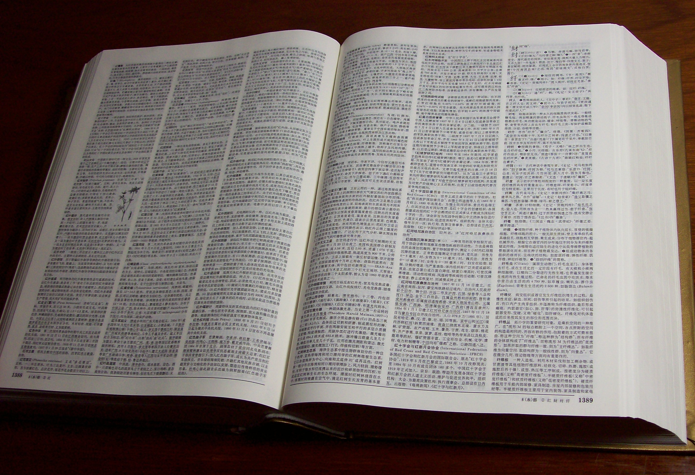
Dictionary-Go-Round

Slide 7
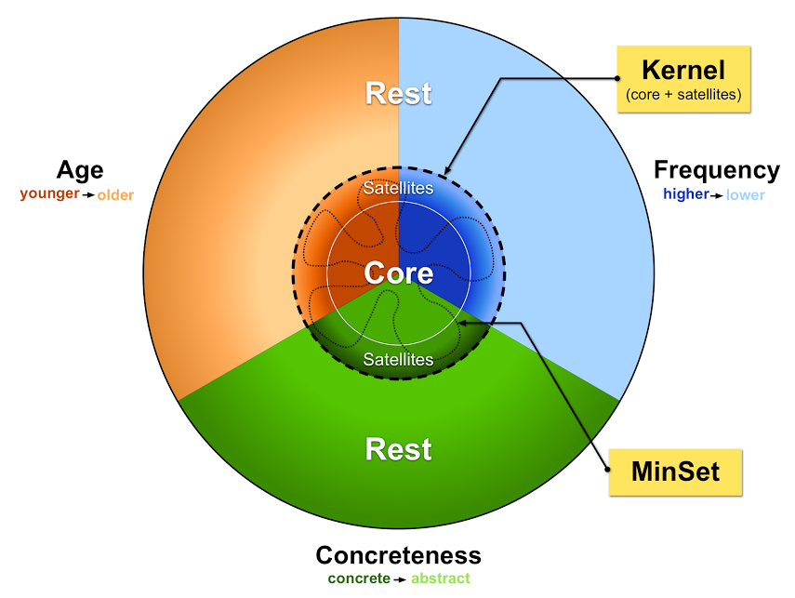
Dictionary Hidden Structure: Kernel, Core, Satellites and Minimal Grounding Sets

Slide 8
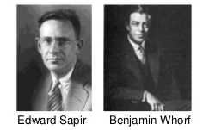
The Whorf Hypothesis
“Language influences the way we perceive the world”

Slide 9

Rainbow & “Pop-Out”

Slide 10
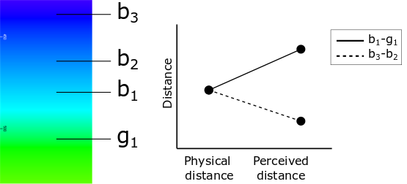
Categorical Perception

Slide 11
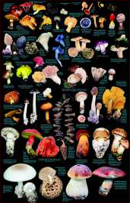
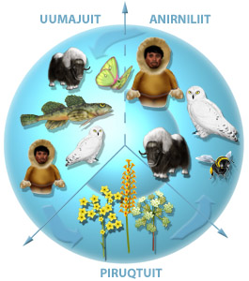
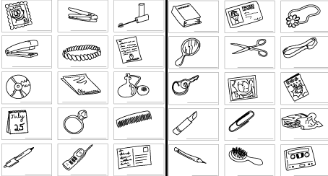
Category Learning

Slide 12
Can CP be induced by category learning?

Slide 13
Learned CP’s Signature “<”
Before Category Learning – Category Learning – After Category Learning

Slide 14
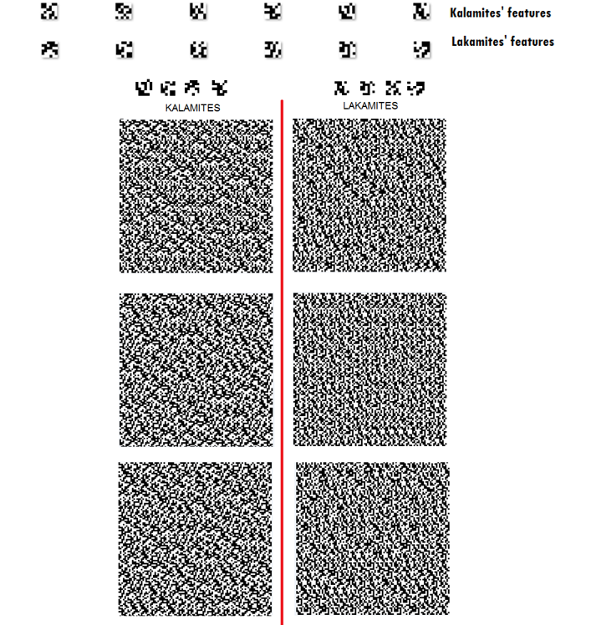
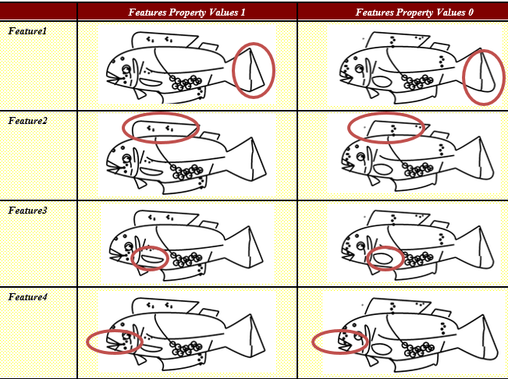
Textures (“Kalamites” & “Lakamites”) & Fish (“Kalefish” and “Limfish”)

Slide 15
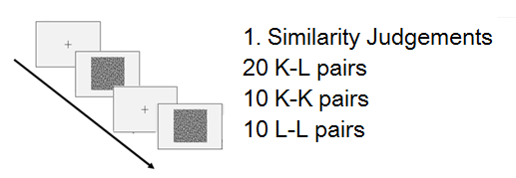
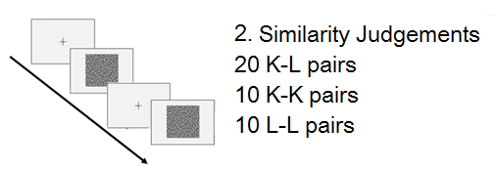
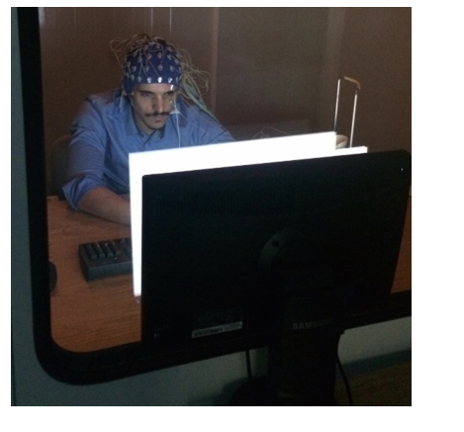
Before Category Learning – Category Learning – After Category Learning
Category learning with corrective feedback

Slide 16
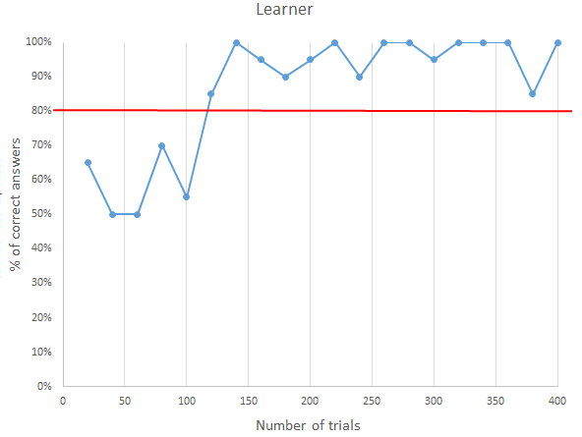
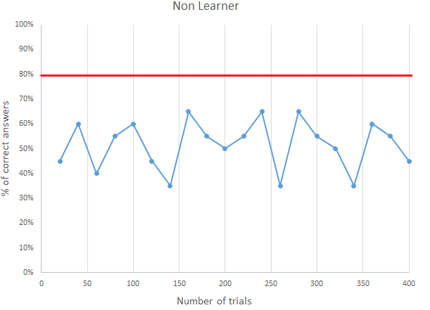
Learned CP: Performance & Perception

Slide 17
Learned CP’s Signature “<”

Slide 18
Learned CP: Electrocortical Correlates

Slide 19
Category Learning, Yes, But Why CP?

Slide 20
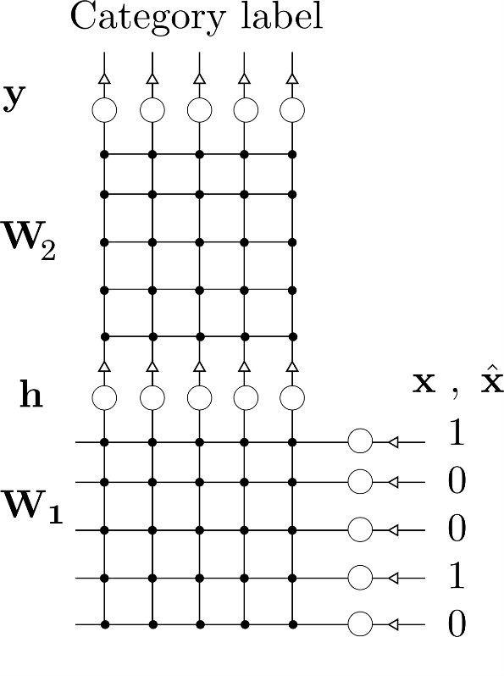
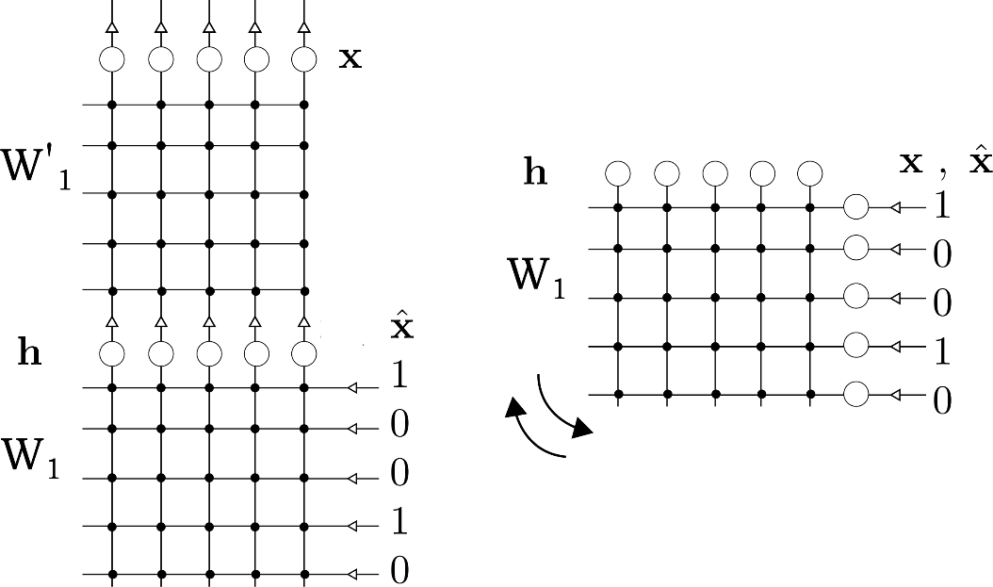
A Neural Net Model
Basic autoencoder architectures :
on the right, with a self connected hidden layer.
Basic classification network with one hidden layer initialized with autoencoding.

Slide 21
Humans: Before Category Learning – Category Learning – After Category Learning Nets: Autoencoding – Supervised Category Learning – After Category Learning Hidden layer distance between and within categories before and after supervised category learning

Slide 22
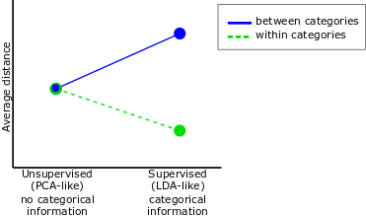
Learned CP’s Signature “<”

Slide 23
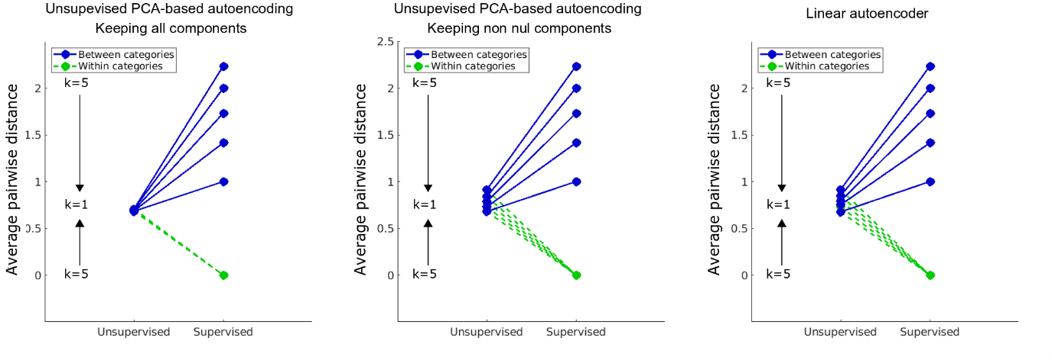
N Binary Conjunctive Features (Dimensions) k of them category-covariant

Slide 24
Dimensionality Reduction: N To k

Slide 25
Learned Feature Filters

Slide 26
Pop-Out of Grounded Categories

Slide 27
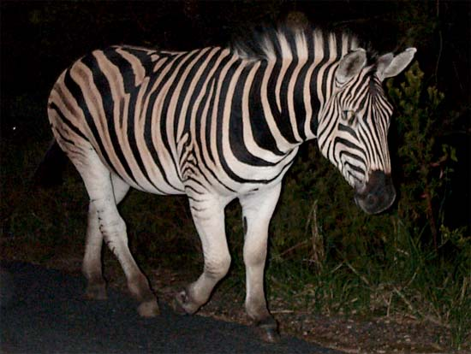
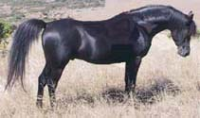

The power of natural language: Grounded recombinatory propositions defining new categories
“ ‘ZEBRA’ = HORSE + STRIPES ”
+
=

Slide 28
Dictionary-Go-Round

Slide 29
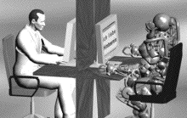
Turing-Robots And Turing-Scale Grounding

Slide 30
Vincent-Lamarre, P., Blondin-Massé A. Lopes, M., Lord, M., Marcotte, O., & Harnad, S. (2016). The latent structure of dictionaries. Topics in Cognitive Science, 8(3), 625-659.
Vincent-Lamarre, P., Lord, M., Blondin-Massé A., Marcotte, O., Lopes, M., & Harnad, S. (2017). Hidden Structure and Function in the Lexicon. In Cognitive Approach to Natural Language Processing (pp. 91-108).
Pérez-Gay, F., Thériault, C., Gregory, M., Sabri, H., Harnad, S., & Rivas, D. (2017). How and why does category learning cause categorical perception? International Journal of Comparative Psychology, 30.
Pérez-Gay, F., Sicotte, T., Thériault, C., & Harnad, S. (2018). Category learning can alter perception and its neural correlates. arXiv preprint arXiv:1805.04619.
Thériault, C., Pérez-Gay, F., Sicotte, T., Rivas, D., & Harnad, S. (2018). Learning-induced categorical perception in a neural network model. arXiv preprint arXiv:1805.04567.

Slide 31
Thank You
Fernanda Pérez Gay
Christian Thériault
Tomy Sicotte
Dan Rivas
Alexandre Blondin-Massé
Philippe Vincent-Lamarre
Odile Marcotte
Marcos Lopes

